Slide 1
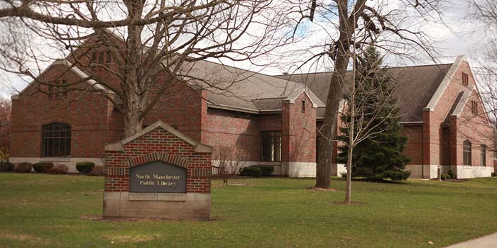
Future Librarians of NMPL:
Mock Interview

Slide 2

Interview
Opportunity to tell the library:
Who you are
What your skills are
Why they should hire you
How you will help the library

Slide 3
Opportunity to find out:
Who you will be working with
What you will be doing
What you will be paid
When you would start/hear back
Why they need to hire someone

Slide 4

Sell yourself!
Dress your best
Shake hands firmly
Make eye contact
Speak clearly
Don’t ramble

Slide 5
NMPL Interview Questions
We’d like to start by telling you a little bit about the position of Library Clerk. The Library Clerk is responsible for circulating library materials, providing needed services for library patrons and the community, and maintaining the materials of the library. The Library Clerk reports to the Adult Department Manager in the Adult Department, and the Children's Department Manager in the Children's Department.
Explain the average amount of hours and pay for this hiring position. Confirm availability.

Slide 6
Tell me a little about you and your past work responsibilities.
Tell me about your strengths and weaknesses.
What interested you in being a clerk?
How do you best learn details?
You and a co-worker are having difficulties working together. How would you handle that? What would be your first step?
What qualities do you look for in a supervisor?
What are you like as a person?
Do you care? Are you going to be motivated?
What are you like as an employee?
What is your past work record?

Slide 7
When were you most satisfied in a job? What was it that made you feel that way?
Can you describe a time when your work was criticized? How did you handle it?
Do you have experience working with children? If so, explain.
How would you describe your computer skills?
Any questions about this position or the library?
What is your past work record?
What are you like as an employee?
What skills do you have?
What do you need to know about us?

Slide 8
Mock Interview
Tell me a little about you and your past work responsibilities.
Focus on things that connect to the job you want
Be honest. This may be your first real job ever. Say so, and then explain why you are still a great candidate!
Do you regularly cook meals for your family? Great! You know how to follow written instructions.
Do you babysit? Great! Parents trust you with their kids and you know how to work with younger ages.
Do you take out the trash without being reminded? You can remember instructions and don’t need someone to check up on you to get your work done.
Do you act in school plays/play sports? You can remember your lines/team plays, work with a group, follow instructions of a director/coach.
Do you volunteer? Shows you care about your community and are willing to work.

Slide 9

Mock Interview
What interested you in being a clerk?
Bad answer: My parents told me I have to get a job.
This tells the interviewer you have no interest in their company and you’re only here because you have to be. They are going to assume that your attitude will be bad and you won’t try very hard.

Slide 10

Mock Interview
What interested you in being a clerk?
Good answer: I’m saving up money to put myself through college and get my first car.
This tells the interviewer that you are someone who sets goals for yourself and will work hard to achieve them.

Slide 11

Mock Interview
What interested you in being a clerk?
Great answers:
I’ve been coming to the library since I was a kid and I always enjoy participating in programs and I would really like to be a part of all of that you do here.
I love to read! Books are one of my favorite things and it excites me to think about helping other people find books.
I was checking out your website and Facebook page and I was really impressed by all that you offer. I think it’s so cool that people can come to the library to 3D print and I love that you have programming for all ages.
Why are these great answers?

Slide 12

Mock Interview
What interested you in being a clerk?
Stellar answers:
Great answer + I enjoy being around people and I’m a hard worker. I think I could be a good fit for everything you do because I would work hard to help people who came to the library and I would be friendly and make them feel welcome so they would want to come back.
Great answer + I really love technology and helping people learn how to use it. I think I would be a good fit for the library because I would be able to help people figure out how to use your 3D printer and copy machine.
Great answer + I read a lot of books in my own time and I enjoy talking about the books I’m reading. I think I would be a good fit for the library because I would be able to help people find books they would enjoy and tell them about new books they could check out.

Slide 13
Mock Interview
What interested you in being a clerk?
The ingredients of a stellar answer:
Demonstrate knowledge about the library + talk about your strengths + state how you would use your strengths to help the library = Stellar answer

Slide 14

Mock Interview
Tell me about your strengths and weaknesses.
Be honest and don’t be modest. Let people know how great you are - especially in ways that tie into the job!
I’m really good at following instructions and remembering to do what I’m asked.
I’m friendly and enjoy being around people and making them happy.
I’m a hard worker and dependable. If I say I’m going to be somewhere, I will be there. I don’t like showing up late to things.

Slide 15
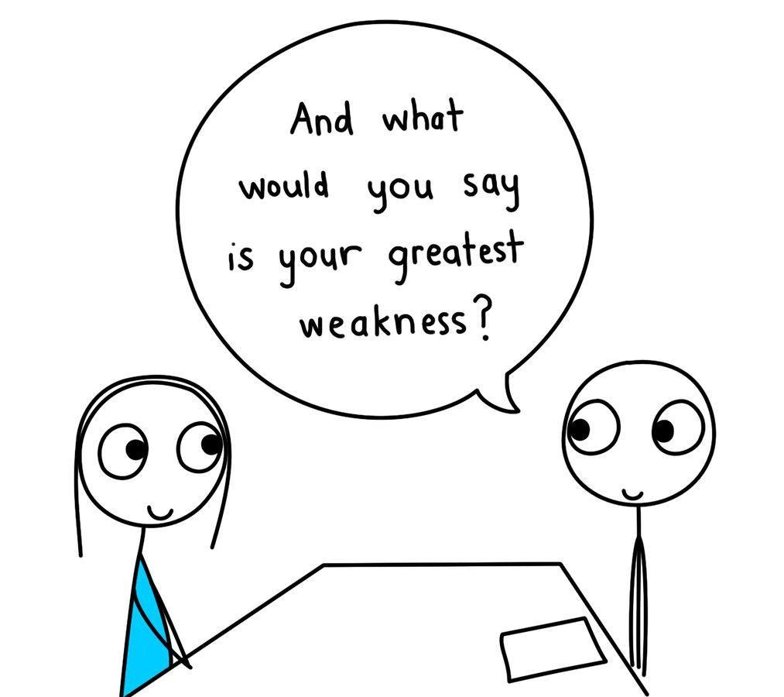
Mock Interview
Tell me about your strengths and weaknesses.
Let the interviewer know anything that could affect your ability to do the job AND your plan to compensate for it.
I’m shy so sometimes it’s hard for me to start conversations with people. It’s something I’m working on though and If I have a job to do, it actually makes it easier for me to talk to people.
One of my weaknesses is remembering things. I don’t have a great memory. But I’ve learned to overcome this weakness by taking lots of notes when I’m learning something and reading them over as often as I need to.

Slide 16

Mock Interview
You and a co-worker are having difficulties working together.
How would you handle that? What would be your first step?
Give an answer that shows your ability to:
Solve a problem, work with others, and follow the proper chain of command. Examples:
I would go to my coworker and ask them if there is anything I can do differently so we can work together better. I would listen to what they had to say and change what I could. If that didn’t work I would go to my supervisor.
I’m not a very confrontational person. If a situation came up like that, I would just keep treating my coworker with kindness. That happened once before at my previous job and by the time I left, this coworker and I were good friends.
To me, the most important thing would be my work. So I would keep focusing on my job and not get caught up in drama. I’d be professional, treat everyone well, and get my work done. If it started to interfere with library tasks, I would talk to a supervisor.

Slide 17
Let’s Interview!

