Slide 1

Future Librarians 2.0
The Card Catalog

Slide 2
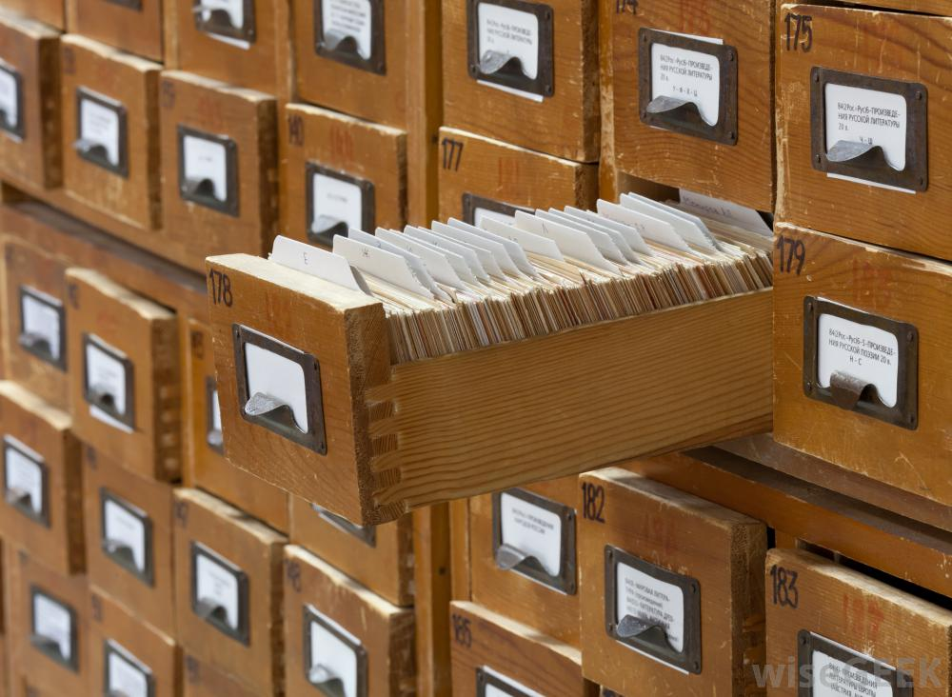

What is a card catalog?
A library card catalog is a system that helps to organize library materials by author, title, or subject.
Library catalogs were originally created to help librarians keep track of their books, but they also serve as a great way for patrons to find what they are looking for. Library catalogs are important tools used to find books and other materials.

Slide 3
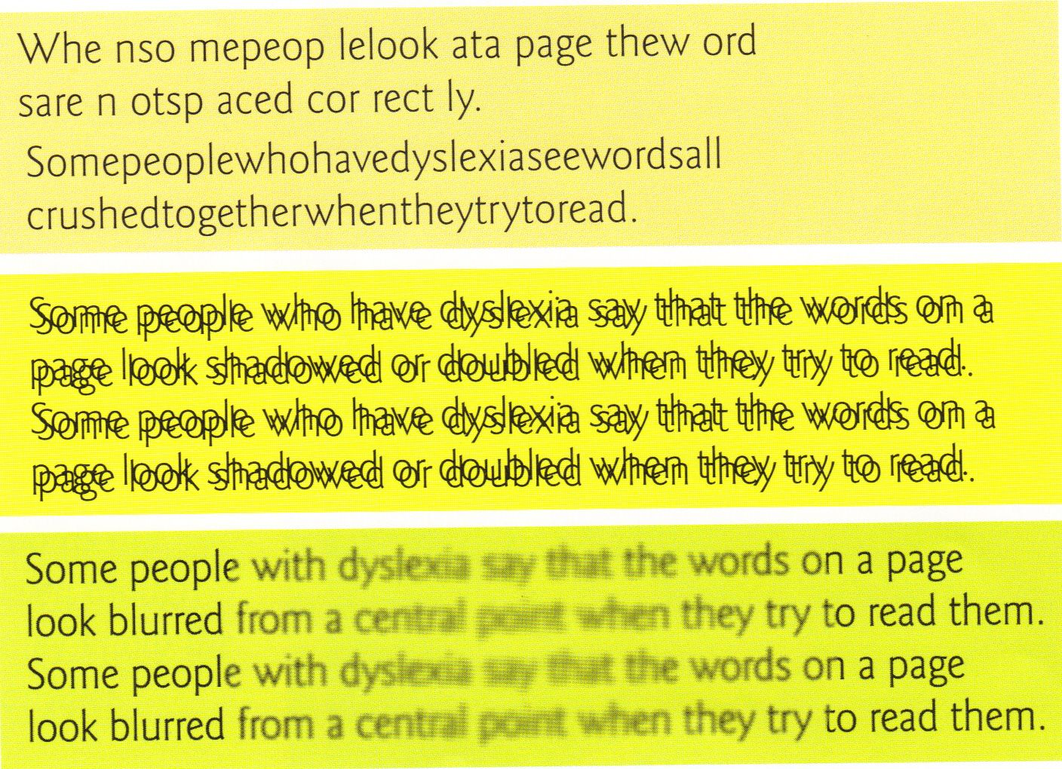
Assisting Patrons: Dyslexia
Dyslexia, previously known as word blindness, is a learning disability that affects either reading or writing. Different people are affected to different degrees. Problems may include difficulties in spelling words, reading quickly, writing words, "sounding out" words in the head, pronouncing words when reading aloud and understanding what one reads

Slide 4
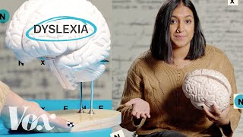
Notes:
first 1 minute 40 seconds

Slide 5
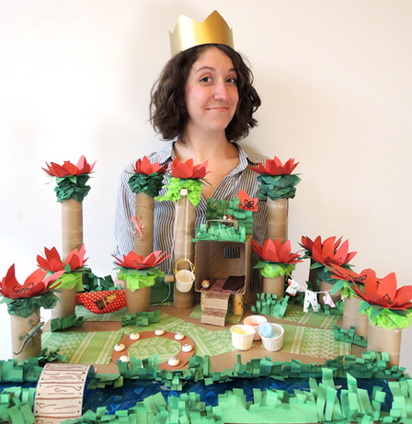
The Dyslexic Librarian
Notes:
Describe your relationship with books when you were growing up.
We usually hear about the negative aspects of reading and Dyslexia (Ex: Dyslexia means you can’t read, you can’t enjoy books). Do you have some positive associations with reading and dyslexia?
Projects

Slide 6

Notes:
First 2.5 minutes

Slide 7


Assisting Patrons
As a Librarian, some patrons or coworkers may require more time or more assistance due to a learning difference, especially when it comes to using the card catalog. Being aware of this will make you an even more effective librarian!
Lack of computer skills (older patrons) can also play a factor. Other people may have health challenges (poor eyesight, medication that makes it hard to focus, etc.). You may not always know why someone is struggling BUT you can be there to help them!

Slide 8
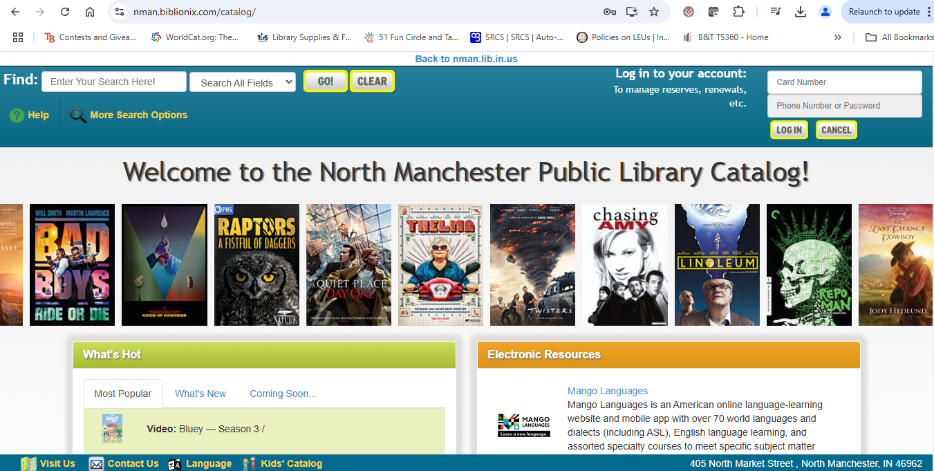
Let’s check out NMPL’s card catalog!
https://nman.biblionix.com/catalog/

Slide 9
When/Why would you use each of these searches?
- you/patron know the exact name of the book you want
- you/patron really like a book you read and want to find more by the same person
- you/patron want to see if there are any new books in your favorite series
- you/patron need to know more about a certain topic
Title
Author
Series
Subject

Slide 10
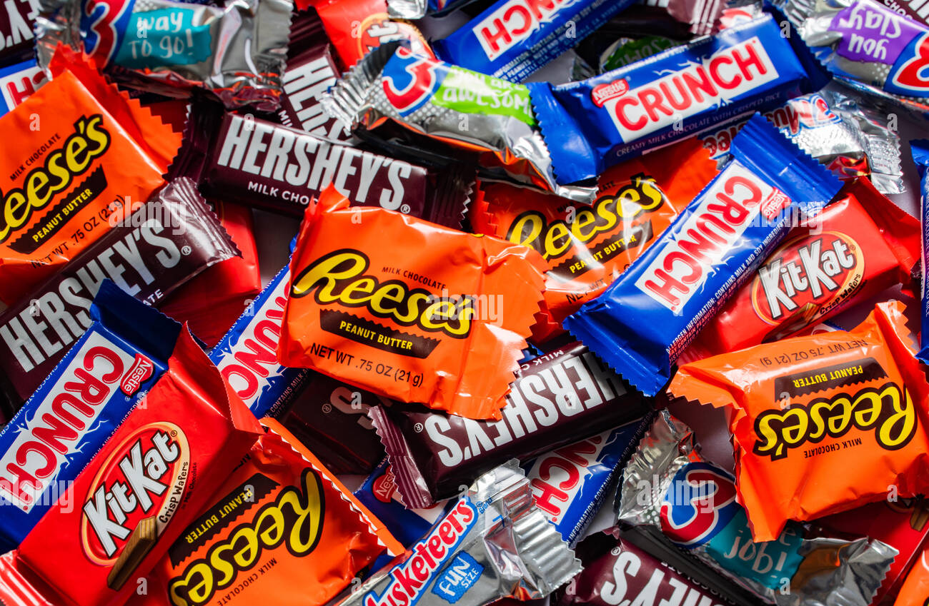
Bingo!

Slide 11
Title - must provide Availability
Author - must provide Title
Series - must provide Call Number
Subject - must provide Sublocation

Slide 12
I survived
Series - must provide Call Number

Slide 13
The Silver Chair
Title - must provide Availability

Slide 14
Barbara Park
Author - must provide Title

Slide 15
My Mexican Kitchen
Title - must provide Availability

Slide 16
Maya and the Rising Dark
Title - must provide Availability

Slide 17
Elephant & Piggy
Series - must provide Call Number

Slide 18
Mazes
Subject - must provide Sublocation

Slide 19
H. A. Rey
Author - must provide Title

Slide 20
Optical Illusions
Subject - must provide Sublocation

Slide 21
Before She Was Harriet
Title - must provide Availability

Slide 22
Matt Christopher
Author - must provide Title

Slide 23
Days of Zero
Title - must provide Availability

Slide 24
William Bee
Author - must provide Title

Slide 25
A Series of Unfortunate Events
Series - must provide Call Number

Slide 26
Gary Paulsen
Author - must provide Title

Slide 27
Pigs
Subject - must provide Sublocation

Slide 28
Shannon Hale
Author - must provide Title

Slide 29
Encyclopedia Brown
Series - must provide Call Number

Slide 30
American Sign Language
Subject - must provide Sublocation

Slide 31
Nancy Drew
Series - must provide Call Number

Slide 32
Cookbook about decorating
Subject - must provide Sublocation

